Slide 2
Neighborhood Meetings Summary
Pursuant to President Frank’s mandate, we engaged directly with CSU Neighbors regarding the Feasibility Study and the Facility Impacts on Traffic, Parking, Sound and Light
Two Meetings: July 26 and July 30 at Plymouth Congregational Church from 5:00 pm – 7:00 pm
Invite list developed by CSU and City of Fort Collins included 540 households directly south of campus (if project moves forward, neighborhoods north, west and east will be engaged)

Slide 3
Neighborhood Meetings Agenda
Feasibility Study Status Report
Site Selection
Program and Design
Traffic and Parking
Sound and Light
Neighbor Input and Q&A

Slide 4
Parsons Brinckerhoff
PB Sports Transportation Planning and Traffic Engineering
Parking Master Plans
Parking Lot Pricing
Parking Management Plans
Zoning and Permitting
Building & Site Circulation
Service Vehicle Access
Vehicle Security
Pedestrian Circulation & Security
Crowd Control
Tailgating
Opening Day Management Plans
Police – Traffic Management
Traffic Access & Circulation
Traffic Modeling & Signal Design
ITS Systems Integration
Transit Routing
Incident Management
Interstate Signage
Wayfinding Signage
Web Travel Routes/Parking Info
Community Outreach – Patron Education

Slide 5
Parsons Brinckerhoff
Colorado State Univ – Hughes Stadium
Baylor University Site Selection
Vanderbilt University – Parking Master Plan
Univ of Louisville – Papa Johns Stadium
Ohio State MP - Value City Arena
Univ of Minnesota – New Stadium
Super Bowl XL Detroit
Dallas Cowboys 2009 New Stadium
Vikings Site Selection- 2011-12
Gillette Stadium – NE Patriots
Dolphin Stadium - Super Bowl MP
Seattle Seahawks – Qwest Field
New Orleans Saints – New Stadium
Pittsburgh Steelers – Heinz Field
Cincinnati Bengals - Brown Stadium
Truman Center – Chiefs and Royals
Cleveland Browns – Browns Stadium
Charlotte Bobcats - Bobcat’s Arena
Disneyland Anaheim Theme Park, CA
USTA – US Open Tennis Tournament
Rock ‘n Roll Hall of Fame
Dubai F-1 AutoDrome Dubai, UAE
Univ of Pittsburgh - Heinz Field Pitts, PA
Montclair State University MP, New Jersey:
Ohio State Parking Garage Assessment
Westfield St. Field House, Westfield, MA
MIT Construction Mitigation Services
MLB – Site Selection Study 2009-10
Cincinnati Reds – Great America Ballpark
New Jersey Nets - New Arena
Cleveland Indians – Jacob’s Field
Pittsburgh Pirates – PNC Park
Seattle Mariners – Safeco Park
Oakland A’s – New Ballpark
Washington Nationals – Transportation

Slide 6
Traffic and Parking
Stadium Projects in Urban Locations are Always Challenging
Initial Assessment for 90 Day Feasibility Study
High Level Evaluation to determine if there are any access and parking logistics that would create any fatal flaws
Assessment based on collaboration with the following:
CSU – Parking, Facilities Management, Athletics, University Architect
City of Fort Collins - Traffic Operations, Parking Services, Transportation Budget Manager
Colorado Department of Transportation (“CDOT”), Traffic Engineering Branch
July 26 and July 30 Neighborhood Meetings

Slide 7
Traffic and Parking
If Project Moves Forward:
Develop Comprehensive Transportation Management Plan
Define Parking Strategy in collaboration with CSU, City of Fort Collins, surrounding neighborhoods and Colorado Department of Transportation
Continued Neighborhood Engagement specific to traffic, parking and circulation planning

Slide 8
Traffic and Parking
Key Questions for Assessment
Does the roadway network have enough capacity to accommodate the traffic surges?
Is there enough CSU Parking to accommodate the demand?
Are there opportunities for Private Parking to reduce demands on CSU?
Are there alternative modes of transportation to reduce traffic and parking demands?

Slide 9
Traffic and Parking
Existing Roadway Network
Regional Access – 3 Primary Interchanges
Primary Access – Mulberry, Prospect, Harmony
Secondary Access – College and Shields
New Traffic data cannot be taken due to current construction on Mason Street Corridor
With operational enhancements, the existing roadway network capacity can accommodate On-Campus Stadium

Slide 10
Traffic and Parking
Parking Demand
Parking Demand is related to Transportation Options and Modal Splits
Conservative Approach used in Assessment: Low end of modal split assumptions used to develop parking demand

Slide 11
Traffic and Parking
Modal Split % of Patrons # Patrons
Walkers and Bicycles 20% to 30% 8,400 to 12,600
Mason Street Corridor 3% to 5% 1,260 to 2,100
Existing Transit System - Transfort 0% to 1% 0 to 420
Shuttles from shopping/restaurant areas 0% to 2% 0 to 840
Remote Park and Ride 0% to 2% 0 to 840
Modal Split Goals 23% to 40% 9,660 to 16,800
Stadium Capacity 42,000
Patrons requiring University Parking Support 32,340 to 25,200
Parking Demand
Vehicular Occupancy 32,340 25,200
3.0 10,780 8,400
3.2 10,106 7,875
Results of Analysis
Estimated Demand of 7,875 – 10,780 vehicles excluding any other forms of transportation

Slide 12
Potential CSU Parking Supply
Potential CSU Parking Supply 13,461 spaces
CSU Parking Inventory 11,461
8,976 spaces within 20 minute walk of stadium Site C (availability is TBD)
2,485 spaces in new parking garages (Shields/Laurel; Pitkin; Whitcomb/Prospect), on-street (Whitcomb St. Extension), and reconfigured parking (Meridian Walk)
CSU Property, South Campus 2,000

Slide 13
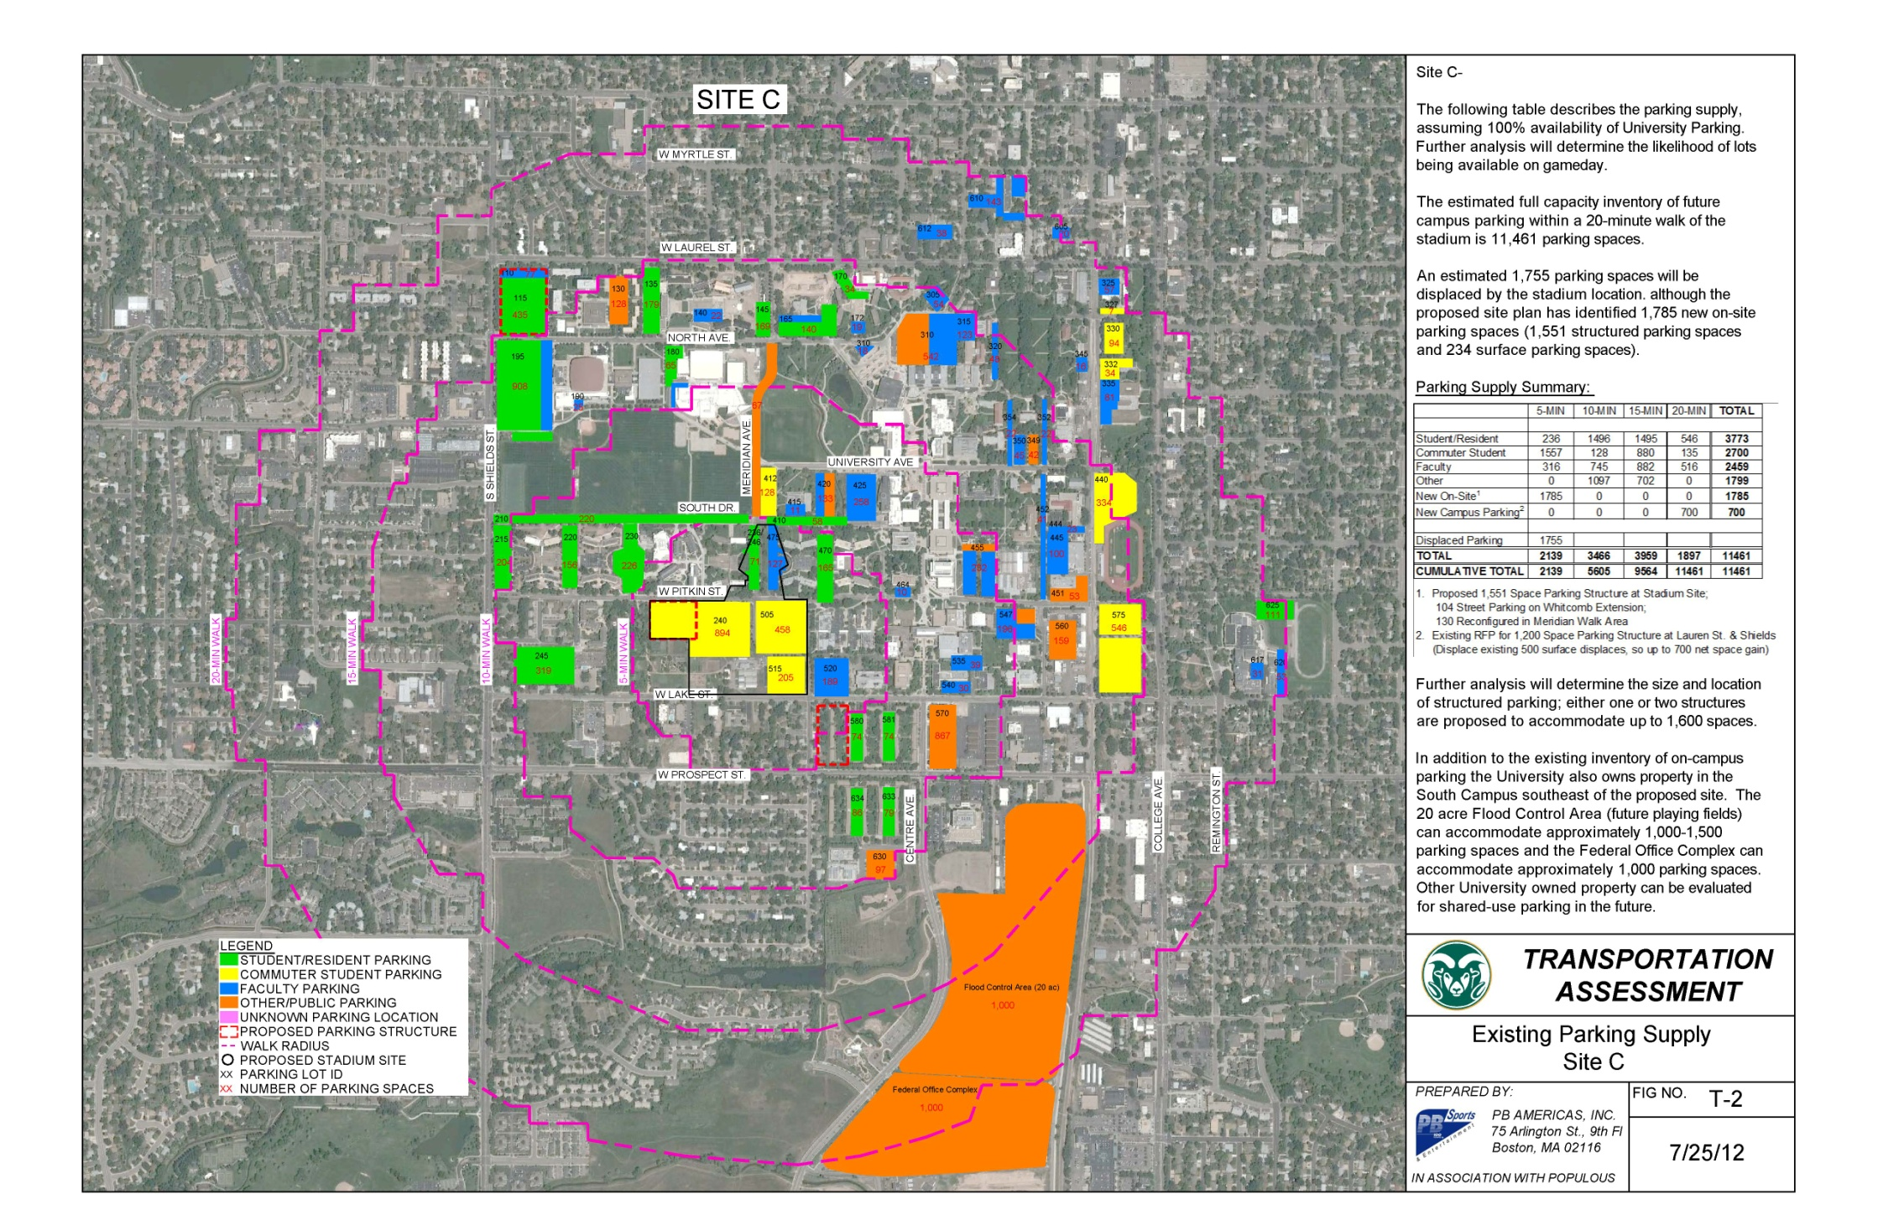
Potential CSU Parking Supply
Use of Maps?

Slide 14
Off Campus Potential Parking Supply
Off-Campus Potential Parking Supply 13,500 to 17,000
Parking in Downtown Ft. Collins 11,000
Public 5,599 (Availability to be determined)
Private 5,500 (Availability to be determined)
Parking in Local Businesses closed on Weekends (est) 1,000 to 2,500
Parking in Shopping Centers and along Harmony (est) 1,000 to 2,500
Park and Ride – Visitors Center or in Denver (est) 500 to 1,000

Slide 15
Traffic and Parking
Next Steps (if project is approved)
Develop a Comprehensive Transportation Management Plan in collaboration with CSU, City of Fort Collins, surrounding neighborhoods, and CDOT to understand the impact on CSU, identify opportunities within Fort Collins, and develop strategies to manage game day traffic and parking
Document Issues & Concerns
Neighborhoods, CSU, City of Ft. Collins & Other Stakeholders
Refine Modal Split Assumptions – Create Goals
Refine the Site Design (access and circulation)
Parking, Shuttles/Busses, Accessibility, Service Vehicles, etc.
Develop Transportation Strategy to Reduce Parking Demand
Minimize driving around looking for a space (“hunt and peck” phenomenon) by pre-packaging parking along with the ticket purchase

Slide 16
Sound and Light
SOUND
WJHW - A/V consultant
on cutting edge of Audio and Video Technology in sport design for nearly 25 years.
ACTIVITES TO DATE
Developed an A/V Narrative for this feasibility study, including an outline on Audio Systems:
Defined Seating Bowl sound system types (Max 100DbA continuous)
Outlined means of achieving best combination of performance, cost and aesthetics
Described audio feeds and auxiliary audio systems that power and supplement the audio design
Explain preliminary modeling (using Sound Plan software)

Slide 17
Sound and Light
In WJHW’s preliminary investigation, the following were identified as the largest sources of sound from a new stadium:
Amplified sound from the PA system (down/distance or rhythmic/music content)
‘Home Scoring’ crowd noise
Special effects sound (such as the CSU celebratory cannon)
MOVING FORWARD (If Project is Approved)
Further develop the Sound simulation model based upon finalized architectural design
Communicate with project stakeholders on sound transmission to make prudent design decisions
Work closely with CSU, the City of Fort Collins and Neighborhood groups to:
Pursue policies that are to the benefit of City residents
Agree upon mitigation measures that limit impact of sound such as
Number of events
Time of day
Other uses

Slide 18
Sound and Light
SPORTS LIGHTING
M-E Engineers - Denver based MEP/FP/Sports Lighting Consultant.
on the cutting edge of sport lighting design for NFL/NBA/NHL/NASCAR/OLYMPIC and NCAA sports facilities.
ACTIVITES TO DATE
Developed MEP/FP Narrative for feasibility study, including an outline on Sports Lighting
Defines the lighting illumination criteria (150FC standard broadcast requirement)
Identifies the types of sport lighting manufacturers (for pricing purposes)
Establishes illumination guidelines which restrict spill levels on adjacent neighborhoods or roadways
Describes measures which shield, restrict and aim light sources appropriately
Outlines commissioning processes to optimize illumination of the playing field but restricts glare and spill outside of the stadium

Slide 19
Sound and Light
MOVING FORWARD (If Project is Approved)
M-E and Populous will strive to achieve an efficient and environmentally sound lighting design by:
Abide by applicable codes defining lighting regulations
Define the design criteria which will limit light spill and glare
Define existing light levels to give a point of reference for typical night time conditions
Evaluate the architectural model to determine appropriate sport lighting positions
Create a lighting calculation model from the completed architectural design
Provide quality assurance through field observation and measurement
Interpret the calculation results to ensure the project meets design criteria and regulations

Slide 20
Neighborhood Meeting Summary
Areas of Questioning/Comments
Traffic and Parking
Sound and Light
Cost and Budget
Design and Construction
General Comments

Slide 21
Neighborhood Comments
Traffic and Parking Concerns
Everyday Student Parking in Neighborhoods
Stadium Parking in Neighborhoods
Pedestrian and Bicycle Circulation
Increased Traffic on Prospect
Neighborhood Access on Game Day
Challenge of Railroad Crossings on Game Day
Sound and Light Concerns
Noise Disturbance During Events
Light Disturbance During Events

Slide 22
Neighborhood Comments
Cost and Budget Concerns
Cost to the City of Fort Collins for Infrastructure Improvements
Relocation of PERC Gardens and Greenhouses
Additional Budget Items Beyond Stadium Scope
Parking Garage
PERC Relocation
Alumni Center
Phase 2 of Meridian Walk

Slide 23
Neighborhood Comments
Design and Construction Concerns
Length of Construction
View Plane
Reduction of Green Space

Slide 24
Neighborhood Comments
General Comments and Questions
Polarization of Fort Collins community on stadium issue
Why not continue to use Hughes Stadium?
Who will operate the building during non-athletic events?
Security of neighborhoods and adjacent property with influx of football fans
Impact on property values

