Slide 2

Firm Background
CSL International
Industry-leading sports & entertainment facility feasibility advisor
Founded in 1988 by former Partners, Directors & Consultants with Coopers & Lybrand (now PwC)
Sports Practice
Based in Dallas, TX
Over 120 years of collective experience
Over 1,000 feasibility studies completed
Extensive collegiate experience (Baylor, Minnesota, Akron, etc.)
Proven track record with credibility in the marketplace
Independent, unbiased research and analysis
EXPERTISE:
Market Demand
Facility Program
Financial Feasibility
Marketing Strategies
Operational Reviews
Economic Impacts
Funding Plans
Valuations
Business Plans
1

Slide 3

































Collegiate Stadium Experience
TCF Bank Stadium
Minnesota
Autzen Stadium
Oregon
Bronco Stadium
Boise State
Baylor Stadium
Baylor
Husky Stadium
Washington
Notre Dame Stadium
Notre Dame
FAU Stadium
Florida Atlantic
Martin Stadium
Washington State
Kenan Stadium
North Carolina
Kyle Field
Texas A&M
Sun Devil Stadium
Arizona State
Ross-Ade Stadium
Purdue
Amon Carter Stadium
Texas Christian
Reser Stadium
Oregon State
Spartan Stadium
Michigan State
Darrell K. Royal Stadium
Texas
Folsom Field
Colorado
Williams-Brice Stadium
South Carolina
Jones AT&T Stadium
Texas Tech
Scott Stadium
Virginia
Tiger Stadium
Louisiana State
Jack Trice Stadium
Iowa State
Rutgers Stadium
Rutgers
Fargodome
North Dakota State
Lane Stadium
Virginia Tech
Nippert Stadium
Cincinnati
Delaware Stadium
Delaware
Kinnick Stadium
Iowa
Milan Puskar Stadium
West Virginia
Michigan Stadium
Michigan
Proposed Stadium
Memphis
Beaver Stadium
Penn State
Paulson Stadium
Georgia Southern
2

Slide 4
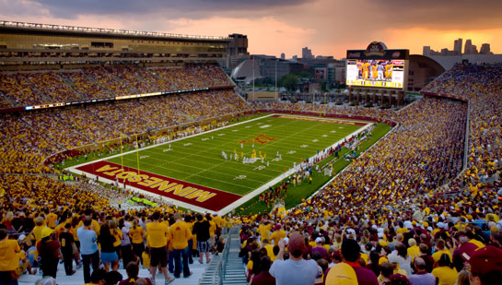

CSL Premium Seating Recommendations
TCF BANK STADIUM
University of Minnesota
Year Opened
Capacity
Project Cost
2009
50,805
$303M
CSL Recommendations vs. Actual Building Program
3

Slide 5
CSL Premium Seating Recommendations
Several recent CSL collegiate football stadium renovation projects
In general, schools followed CSL building recommendations.
Premium seating inventories between 80% and 100% sold
4

Slide 6
Study Components
Comparable
Facilities
Competitive
Facilities
Historical
Analysis
Market Demand
&
Building
Program
Market
Surveys
Financial
Projections
&
Funding
Potential
5

Slide 7
Mountain West Conference Premium Seating
*Utah State and San Jose State will become members of the Mountain West Conference in 2013, following the departure of Boise State and San Diego State.
6

Slide 8
Survey Completion Statistics
7

Slide 9
Survey Respondent Status
Most Common Selections per Survey Group
Ram Club Donors
Non-Ram Club Athletic Donors
Season Ticket Holders
Alumni – 76%
FB season ticket holder – 60%
University donor – 37%
Alumni – 80%
Occasional FB ticket buyer – 53%
University donor – 44%
Alumni – 70%
University donor – 20%
Faculty / Staff – 17%
Occasional Ticket Buyers
Other
Alumni – 75%
University donor – 24%
Faculty / Staff – 21%
Alumni – 69%
Faculty / Staff – 33%
University donor – 12%
8

Slide 10
Attendance Impact of New Stadium
9

Slide 11
Estimated CSU New Stadium Attendance
Estimated Average Attendance
Based on Historical Attendance
10-Year CSU Average Attendance
10

Slide 12
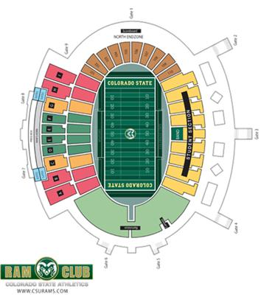
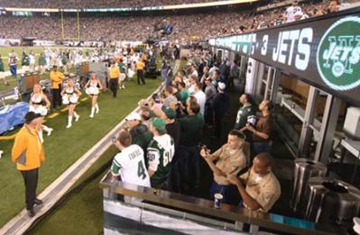
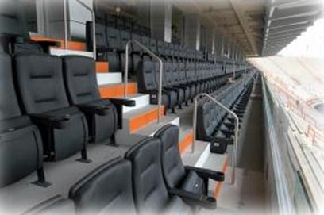
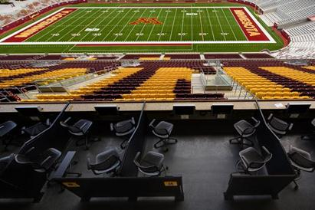
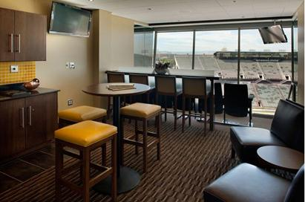
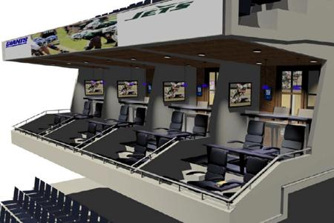
Premium Seating Concepts Tested
Priority Seats
Field Level Club Memberships
Club Seats
Loge Boxes
Luxury Suites
Club Suites
11

Slide 13
Summary of Premium Seating Interest
12

Slide 14
Recommended Building Program
13

Slide 15
Recent Collegiate Naming Rights Values
14

Slide 16
Assumptions Used in Financial Projections
CSL has developed 3 potential operating scenarios.
Attendance has been inflated by 4 percent per year from Year 1 to Year 5.
Attendance remains constant after Year 5.
15

Slide 17
Year 1 Operating Comparison
16

Slide 18
Low Operating Scenario Financial Projections
17

Slide 19
Base Operating Scenario Financial Projections
18

Slide 20
High Operating Scenario Financial Projections
19

