Slide 1
HUGHES STADIUM ANALYSIS
COLORADO STATE UNIVERSITY
P L A N N I N G, D E S I G N AND C O N S T R U C T I O N
Notes:
We have completed a general analysis of Hughes stadium and compared that analysis to the program for the proposed on campus stadium. SLIDE

Slide 2
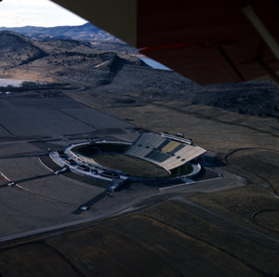
HUGHES STADIUM
OPENED IN 1968 with ~27,000 SEATS on 162 acres at an approximate cost of $3M.
Aerial view of Hughes Stadium - 1969
COLORADO STATE UNIVERSITY
P L A N N I N G, D E S I G N AND C O N S T R U C T I O N
Notes:
Hughes was designed in 1966, constructed in 1967, and occupied just in time for the first game September 1968. The stadium in its original configuration was around 300,000 sqft and had seating for 30,000 fans. in comparison, The proposed on campus is around 640,000 sqft and will accommodate seating for around 43,000 fans. SLIDE

Slide 3
HUGHES PROGRAMMING STUDIES
1999 Hughes Stadium Seating Expansion Options – Identifies options for increasing seating in several different configurations
2003 Hughes Stadium Program Plan – increase permanent and premium seating with associated ADA upgrades. This document was used to inform the design and construction work completed in 2006.
COLORADO STATE UNIVERSITY
P L A N N I N G, D E S I G N AND C O N S T R U C T I O N
Notes:
Between 1968 and today two major studies were completed that identified options for renovations and additions to Hughes. In 1999, HOK sports completed a study w/ a very conceptual cost analysis with several options to add seats in various configurations to the Hughes. In 2003 a program plan was completed describing approximately $15M of work that was completed in 2006. SLIDE

Slide 4
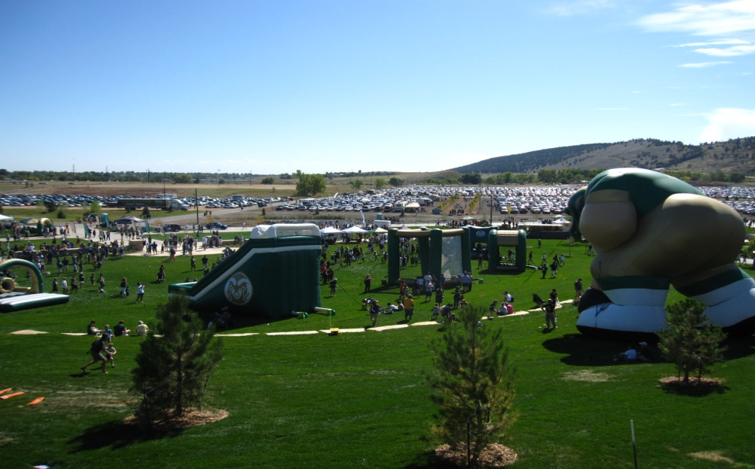
HISTORY OF UPGRADES
2006
Additional seats north end zone
ADA upgrades,
Renovations and Additions to west press box w/ luxury suites and club seating
New scoreboard
2007
Existing playfield replaced
2011
Significant landscape and site improvements
2012
Stadium lighting replaced w/ press box repairs
2002-2012
Numerous minor projects including repairs and renovations to locker rooms, restrooms, and the varsity team room and concession areas
COLORADO STATE UNIVERSITY
P L A N N I N G, D E S I G N AND C O N S T R U C T I O N
Notes:
This work included additions and renovations to the west press box which is now in large part premium seating, additional seats behind the north end zone and the scoreboard replacement. In 2007 the existing play field was replaced. in 2011 we made significant landscape, parking and access improvements and recently replaced the stadium lighting. SLIDE

Slide 5
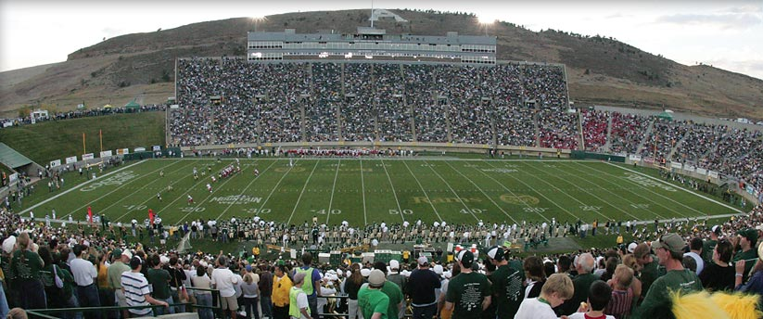
HUGHES STADIUM TODAY
32,500 STADIUM SEATS
120 ADA SEATS
435 CLUB SEATS
12 LUXURY SUITES
10,000 PARKING SPACES
162 ACRES
COLORADO STATE UNIVERSITY
P L A N N I N G, D E S I G N AND C O N S T R U C T I O N
Notes:
With the improvements, today we can accommodate over 32,000 fans, have some premium seating including 435 club seats and 12 luxury suites, and have greatly increased the accessible seating. Steve Hultin then completed an analysis of current operating and compiled the current deferred maintenance list of projects for Hughes with the associated estimated costs…... SLIDE

Slide 7
HUGHES OPERATING COSTS
Current Annual O&M
$150k – Facilities Costs
$159k – Utilities
$310k – Routine
Game Day Support
$96k – Per Game
$578k – Six Game Total
COLORADO STATE UNIVERSITY
P L A N N I N G, D E S I G N AND C O N S T R U C T I O N
Notes:
STEVE

Slide 8
HUGHES DEFERRED MAINTENANCE
$26.4m – Repairs/Replacement Projects
$ 3.6m – Upgrades/Improvement Projects
$30m
10 Year Plan
40 projects needed by 2022
Restrooms – Deteriorated Concrete – Elevators
Seating – Gates – Fencing - Security – Locker Rooms
Carpet – Paint – Asphalt – Parking - Berm - Utilities
COLORADO STATE UNIVERSITY
P L A N N I N G, D E S I G N AND C O N S T R U C T I O N
Notes:
STEVE AND THEN TURN OVER TO MIKE

Slide 9
CURRENT COST TO ADD 17,000 SEATS TO HUGHES STADIUM
DOCUMENTS USED IN THIS ANALYSIS
HUGHES STADIUM SEATING EXPANSION OPTIONS
(seating expansion study done by HOK Sports-8/1999)
CONSTRUCTION COST PROJECTIONS
(for 7 identified options 8/2/1999)
Construction cost inflation figure ( 1999 – 2013) averaged from industry sources
Compared to current Cost/ Square Foot analysis
COLORADO STATE UNIVERSITY
P L A N N I N G, D E S I G N AND C O N S T R U C T I O N
Notes:
The 1999 study focused on seating expansion. The most viable option appears to result in adding approximately 17,000 seats. We studied the very preliminary cost estimates for adding this number of seats in 1999. We averaged a construction inflation factor with input from industry sources including the Turner Construction Cost Index to get us to 2013 costs and then rechecked this number against potential sqft costs in 2013…. SLIDE

Slide 10
1999 ESTIMATED COST TO ADD 17,000 SEATS TO HUGHES STADIUM
North 2*– 7200 Seats : $12M 73,000 GSF
South 1*– 4100 Seats + 600 Seats VIP Level : $10M 45,000 GSF
East 4*– 1100 Club + 4000 Upper Level Seats : $18M 104,000 GSF
17,000 seats : $40M (in 1999 dollars)
*identifies the seating option from the 1999 study; other combinations yield similar results
COLORADO STATE UNIVERSITY
P L A N N I N G, D E S I G N AND C O N S T R U C T I O N
Notes:
This slide show the combination of options derived from the 1999 plan w/ the associated sqft. We used a combination that added seats on the north, south and east sides of the existing stadium. In 1999 the cost to add 17,000 seats form this combination was estimated at $40M. SLIDE

Slide 11
CURRENT ESTIMATED COST TO ADD 17,000 SEATS TO HUGHES STADIUM
Construction cost in 1999 $40,000,000
Construction inflation (1999-2013) X1.7
Subtotal- construction cost in 2013 $68M*
Construction Cost to Total Project Cost factor X1.3
Total Project Cost $88.4M
With allowance range for moderate upgrades $1.6M- $16.6M
Total Project Cost – 17,000 seats only $90M-$105M**
*In reviewing the cost estimates from 1999 and the inflation factor used we also looked at the seating expansion on a cost per square foot basis ($/GSF). In that analysis we find:
Total net square foot (NSF) of seating areas = 212,000 NSF
212,000 NSF X 1.2 GSF factor = 254,400 GSF
254,400 GSF x $270=$68.8M (agrees with estimated construction inflation factor)
**The estimated total project cost for an additional 17,000 seats does not include any of the outstanding deferred controlled maintenance costs, revenue generating amenities or technology upgrades programmed in the new football stadium.
COLORADO STATE UNIVERSITY
P L A N N I N G, D E S I G N AND C O N S T R U C T I O N
Notes:
We then took the $40M X the 1.7 inflation multiplier to get us from 1999 to 2013. This resulted in a construction cost of around $68M today. We checked this against an anticipated cost per sqft and it agreed. We took this number times a 1.3 multiplier to get from construction cost to total project or total development costs to $88.4M. We anticipated some moderate upgrades and developed a range estimate for this which resulted in a total project cost of between $90M and $105M.
The cost to add 17,000 seats to Hughes does not include the necessary revenue generating amenities programmed for the new stadium. The technology upgrades or the current estimated ongoing maintenance, repair and infrastructure upgrade costs…..(AMY ? )….SLIDE

Slide 12
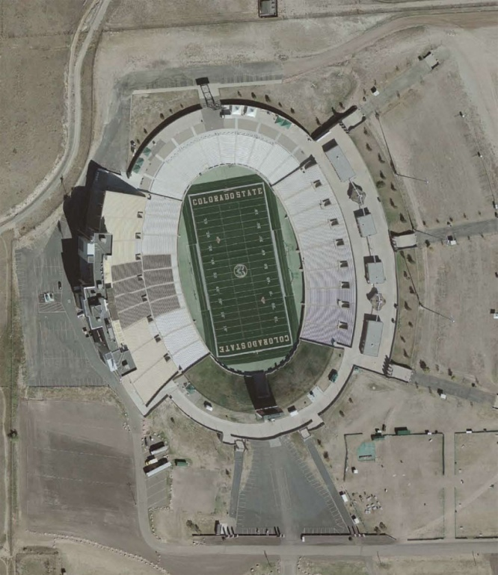
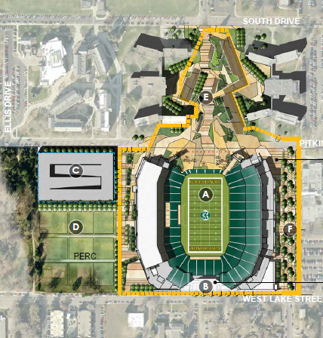
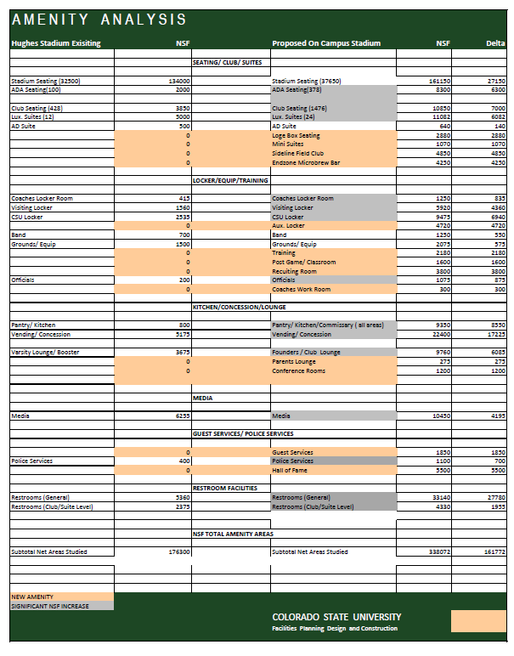
COMPARING AMENITIES
Documents used in this analysis:
Feasibility Report, Draft Building Program, Populous, June 19,2012
Facilities Management space use database and existing conditions floor plans for Hughes Stadium
Amenity Analysis Matrix
COLORADO STATE UNIVERSITY
P L A N N I N G, D E S I G N AND C O N S T R U C T I O N
Notes:
With an overall sqft increase of approximately 300,000 sqft it made a fair amount of sense to compare the existing Hughes stadium to the proposed on campus stadium on a space by space basis. We used our existing data base, the building program developed by populous for the new stadium and developed a space analysis matrix spreadsheet that produced the following results:….SLIDE

Slide 13
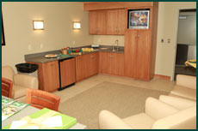
COMPARING AMENITIES - EXISTING
The proposed stadium is programmed with a significant increase in NSF (approximately 100% or greater) for the following areas:
ADA seating
Club Seating
Luxury Suites
Coaches Locker Rooms
Officials
Pantry/Kitchen/Commissary
Vending and Concessions
Lounges and Meeting space
Media
Police Services
Restrooms (general and club/suite)
Players Locker Rooms (Visiting and Home)
Existing Luxury suite
COLORADO STATE UNIVERSITY
P L A N N I N G, D E S I G N AND C O N S T R U C T I O N
Notes:
Spaces that are identified in both facilities but show a significant sqft increase include accessible seating, premium seating, locker rooms, additional space for police services and officials, greatly increased kitchen and concession space, lounge and meeting space as well as media areas…..SLIDE

Slide 14
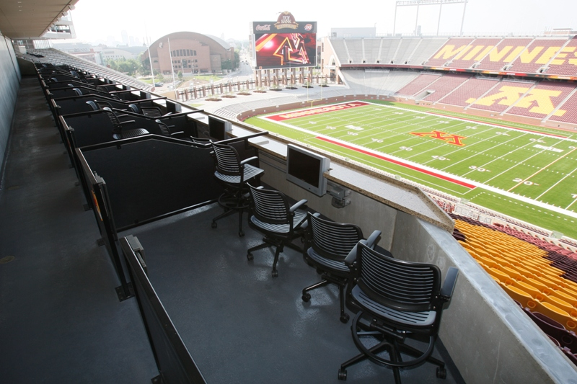
COMPARING AMENITIES - NEW
The proposed stadium is programmed with the following new amenities not currently available at Hughes Stadium:
Loge Box seating
Mini Suites
Sideline Field Club
End Zone Microbrew Bar
Auxiliary Locker Rooms
Training Space
Post Game Meeting Space
Recruiting Room
Coaches Workroom
Parents Lounge
Conference Rooms
Dedicated Guest Services
Hall of Fame
Alumni Center
Loge box seating
COLORADO STATE UNIVERSITY
P L A N N I N G, D E S I G N AND C O N S T R U C T I O N
Notes:
Spaces are not currently available at Hughes but programmed in the new stadium include Loge box seating, Mini suites, a micro brew bar, sideline filed club seating, auxiliary locker rooms, training and post game meeting space, recruiting rooms with hall of fame space, coaches workrooms, parent lounges, additional conference rooms and a alumni and welcome center…… (Amy asks populous, ICON to add to the discussion)

Slide 15
Campus Stadium Comparables

